Slide 1
Car Child Seat Alert System
Presenters: Christopher Atkinson
Prithvi Thimmanayakanahalli Bachireddy

Slide 2
Overview
Concept
System Design
Design Methodology
Requirements
Module Testing
System Testing and Results
Future Scope
Conclusion

Slide 3
Concept
Each year, an average of 37 children die in hot cars in the US
Design a system for monitoring a vehicle for a child left alone in a car
Use an embedded system for monitoring
Connects to software running on PC via Wi-Fi
Utilize a software backend that connects to Amazon Web Services (AWS) Internet of Things (IoT) for communicating with the user
Send an alert via text and email if a child is left alone in a vehicle

Slide 4
System Design
Child Alert System
Embedded System
IoT Server
Hardware
Software
SNS
Sensors
Wireless Hardware

Slide 5
Entity Relationship Diagram
Child
Embedded System
Monitor
Sensors
Monitor
Driver
AWS IoT
Communicates with
Alerts

Slide 6
Hardware Selection
Arduino Nano 33 IoT selected as embedded system processor
Contains onboard Wi-Fi/Bluetooth module
3-wire strain gauges
Used in pairs to monitor driver and child
Generates a voltage differential when force is applied
HX711 ADC board
Combines strain gauges in Wheatstone bridge
24-bit ADC communicates with Arduino
Allows Arduino to read voltage difference from strain gauges

Slide 7
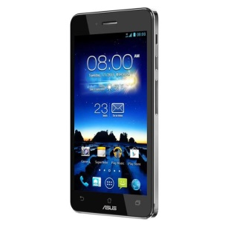
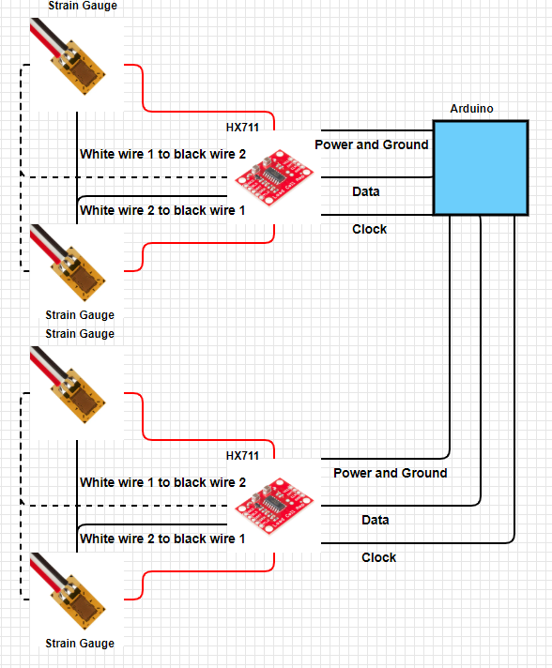
Detailed System Diagram
AWS IoT
AWS SNS
PC Console
SMS
Email
Wi-Fi
Embedded System

Slide 8
Data Flow Diagrams
Level 0
Child Alert System
Sensors
Input data
Alert
Output data
Level 1
AWS IoT
Alert
Send an Alert
Send an Alert
Embedded System
Sensors
Sensor Status

Slide 9
Design Methodology
Project used the Agile methodology throughout development for several reasons:
Short project timeline
Rapid development
Adaptation to changes
Project was divided into three phases:
Identify system and subsystem requirements
Includes choosing hardware and programming languages
Subsystem design, implementation, and testing
System integration and testing
Short weekly meetings held to discuss problems, design, and progress

Slide 10
Requirements
System Requirements
[SYSFUNCT001] The system shall consist of hardware and software components that have the capability of monitoring a vehicle for the presence of a driver and child as well as the capability of alerting a user via text or email.
[SYSFUNCT002] The system shall have a user-configurable delay for signaling an emergency event.
[SYSPERF001] The system shall alert a user within 30 seconds (1-sigma) of an emergency event.
[SYSPERF002] The system shall alert a user for the second time with 3 minutes delay if no action is taken for the first alert.

Slide 11
Requirements
Embedded System Requirements
[ESFUNCT001] The hardware shall consist of an embedded system with one or more microprocessors, one or more sensors, and the hardware to support a wireless communication method (WI-FI or Bluetooth preferred).
[ESPERF001] The hardware shall transmit an alert to the backend system within 15 seconds (1-sigma) of an emergency event.

Slide 12
Requirements
Backend Requirements
[BEFUNCT001] The software shall receive notifications wirelessly (using WI-FI or Bluetooth) from the hardware and transmit a notification to the user via text message or email.
[BEFUNCT002] The software shall be written in a high-level programming language such as C++, Java, or a similar language.
[BEPERF001] The software shall transmit an alert to the user within 15 seconds (1-sigma) of an alert received from the hardware.

Slide 13
Testing Plan
Testing plan designed for system and subsystem designs
Subsystem modules tested individually before integration to verify requirements compliance and functionality
System then integrated and tested

Slide 14
Embedded System Testing
Test Case No | Test Objective | Test Procedure | Expected Result | Actual Result | Test Case Result
1 | Test Arduino WiFi connection | 1. Program Arduino with code that connects to a WiFi connection 2. Print a SSID of the network and the IP address of the Arduino to a serial output | Printed lines to serial monitor that display the SSID of the network and the IP address assigned | Arduino successfully connects and transmits the SSID and ssigned IP address | Pass
2 | Test Driver strain gauge configuration | 1. Wire strain gauges together 2. Connect strain gauges to HX711 3. Connect HX711 to power 4. Apply pressure to strain gauges and monitor the A+ and A- pins for voltage differences with a voltmeter | Extremely small voltage differential will be visible on a voltmeter | Voltage differential of 3-8 mv | Pass
3 | Test Child strain gauge configuration | 1. Wire strain gauges together 2. Connect strain gauges to HX711 3. Connect HX711 to power 4. Apply pressure to strain gauges and monitor the A+ and A- pins for voltage differences with a voltmeter | Extremely small voltage differential will be visible on a voltmeter | Voltage differential of 3-8 mv | Pass
4 | Test Driver HX711 configuration | 1. Connect strain gauges to HX711 2. Connect HX711 to Arduino 3. Program Arduino with a program to read the HX711 | Serial readout of strain gauge force. Result will initially be uncalibrated so may be unusual | Displayed rresulting force in KG. Calibration factor of 7050 chosen to zero scale | Pass
5 | Test Child HX711 configuration | 1. Connect strain gauges to HX711 2. Connect HX711 to Arduino 3. Program Arduino with a program to read the HX711 | Serial readout of strain gauge force. Result will initially be uncalibrated so may be unusual | Displayed rresulting force in KG. Calibration factor of -7050 chosen to zero scale | Pass
6 | Test alert generation code | 1. Apply weight to both strain gauges 2. Remove weight from driver gauge for more than 30 seconds | Serial readout will display a message that a child has been left alone in the car | Received a message on serial readout that a child was alone in the car | Pass

Slide 15
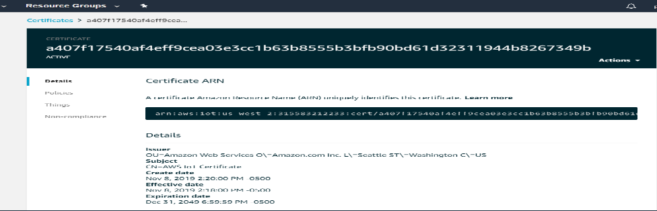
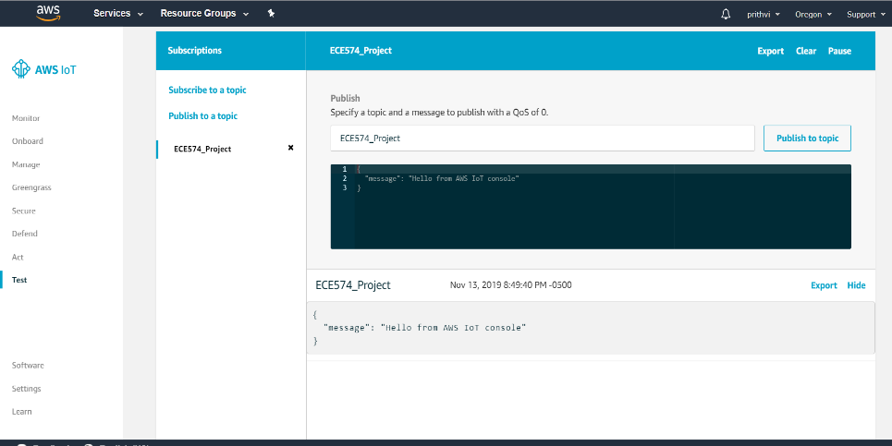
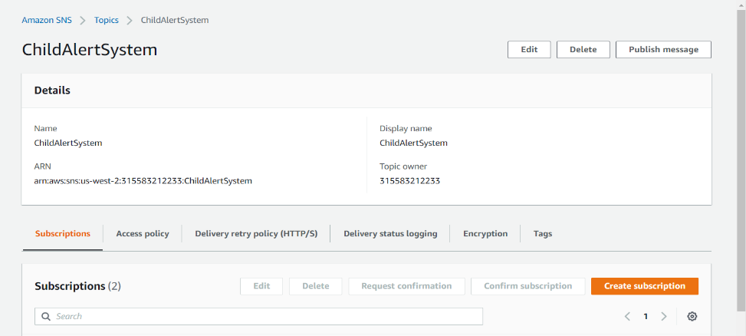
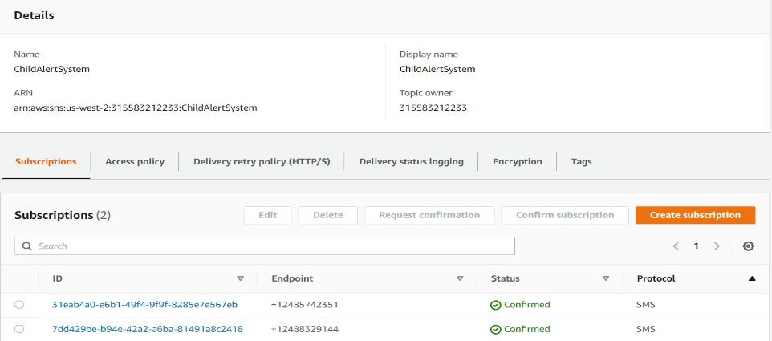
Backend System Testing
Test Case No | Test Objective | Test Procedure | Expected Result | Actual Result | Test Case Result
1 | AWS IOT Topic and Certificate creation ECE574_Project | 1.Create a AWS IOT Account. 2. Register Thing In AWS IOT Console. 3. While Registering Thing,Download Certificates and Keys. 4. Save the Thing ARN for further process. | AWS IOT TOPIC ECE574_Project and Certificate (a407f17540af4eff9cea03e3cc1b63b8555b3bfb90bd61d32311944b8267349b) Should be created and visible in AWS Console. | Certificate visible in AWS Console | Pass
2 | AWS IOT policy creation ECE574_Project | 1. Create Policy in AWS IoT Console 2. Save the Policy ARN. | AWS IoT POLICY ECE574_Policy Should be created and visible in AWS Console | AWS IoT Policy visible in AWS Console | Pass
3 | Attaching the Thing and Policy to Certificates | 1. Open the Generated Certificate in AWS IoT Console. 2. In Actions select Attach Thing. 3.Then again In Actions select Attach Policy | The Policy ECE574_Policy and Thing ECE574_Project should be Attached and visible In the Certificate Console. | Policy and Thing visible in Certificate Console | Pass
4 | Subscribe and Publish a message to the created Topic using AWS MQTT Client | 1. In test Console Enter the Topic ECE574_Project under Subscription Topic. 2. Click on Scbscribe to Topic. 3.Specify a topic and a message to publish with a QoS of 0. 4.Click on Publish to Topic | The Published message should be visible on subscriptions under Thing ECE574_Project. | Published message visible on subscriptions console | Pass
5 | Creation of SNS topic in Amazon SNS | 1. Open Amazon SNS Console. 2. Create a Topic ChildAlertSystem. 3.copy and save the topic ARN | The Topic Child Alert System should be created and visible in Amazon SNS | Child Alert System topic is visible | Pass
6 | Creation of SNS topic Subscription in Amazon SNS | 1.Open the created SNS topic. 2. Click on Create Subscription. 3.Select the Protocol type and enter the endpoint(Mobile Numer). 4.Click on Create Subscription. | The SNS Subscriptions should be created and visible under SNS topic | SNS endpoint subscriptions are visible | Pass
7 | Publishing a message in SNS topic | 1. click on Publish Message. 2.Fill the Message Details and Body and Attributes. 3.Click on publish message. | The Published message should be visible in provided End Point Mobile. | Messages received on mobile devices

Slide 16
System Testing and Results
Procedure
Weight applied to strain gauges
Remove weight from driver gauges
Results
System waits for selected timeframe
Serial monitor provides warning that driver is absent
Texts and emails received on both mobile devices
System-level testing was successful

Slide 17
Future Scope
Temperature sensor
A temperature sensor connected to the Arduino would be a possible source for future work. This number could then be reported along with the alert message.
Adjustable Alert Intervals
An adjustable alert interval is another future improvement that could be made. Ideally this would use the temperature sensor from the previous section to adjust the alert interval based upon the temperature inside the vehicle. This would provide an earlier alert when the temperature reaches more dangerous levels.

Slide 18
Future Scope
Additional Sensors
Additional (preferably plug-and-play) sensors would improve the system, as they would allow for the monitoring of multiple children or even multiple adults. For instance, if an adult is in the passenger seat but the driver is not present (if the vehicle were getting refueled, for example), then there would be no need to send an alert. This would likely require code in the firmware to measure the amount of weight on the sensors and some threshold weight level that determines if the person is a child or an adult.

Slide 19
Conclusion
Developed a child car seat alert system
All requirements successfully met
System monitors seat sensors for a driver and child
Sends text and email alert if child has been left alone in the car

Slide 20
References
Willingham, A. (2018, July 20). Hot Car Deaths Child Charts Graphs. Retrieved 11 28, 2019, from CNN: https://www.cnn.com/2018/07/03/health/hot-car-deaths-child-charts-graphs-trnd/index.html
Sprovieri, J. (2014, July 1). Wire Harness Recycling. Retrieved 11 28, 2019, from Assembly Mag: https://www.assemblymag.com/articles/92263-wire-harness-recycling
Miller, S. S. (2019, 8 9). High-tech alarms go off when kids are left in hot cars. Retrieved 11 28, 2019, from Mashable: https://mashable.com/article/car-seat-alarms-prevent-hot-car-death
Baldwin, D. (2019, 8 21). Life-Saving Car Seat Alarms That Remind Parents There’s a Baby in the Back Seat. Retrieved 28 11, 2019, from Fatherly: https://www.fatherly.com/gear/best-car-seat-alarms/
Marcoux, H. (2019, 7 18). 5 safety apps that remind parents there's a baby in the back seat. Retrieved 11 28, 2019, from Motherly: https://www.mother.ly/news/best-car-seat-sensor-app?rebelltitem=5#rebelltitem5
Wikipedia. (2019, 11 07). Strain Gauge. Retrieved 11 28, 2019, from Wikipedia: https://en.wikipedia.org/wiki/Strain_gauge
Wikipedia. (2019, November 27). Wheatstone Bridge. Retrieved 11 28, 2019, from Wikipedia: https://en.wikipedia.org/wiki/Wheatstone_bridge
Avia Semiconductor. (2017, 1 1). HX711. Retrieved 11 28, 2019, from alldatasheet: https://www.alldatasheet.com/datasheet-pdf/pdf/1132222/AVIA/HX711.html
Digikey. (2014, 5 28). Schemeit. Retrieved 11 28, 2019, from Digikey: https://www.digikey.com/schemeit/project

Slide 21
References
Software. (2015, 5 15). Retrieved 11 28, 2019, from Arduino: https://www.arduino.cc/en/Main/Software
Wikipedia. (2019, 11 5). MQTT. Retrieved 11 28, 2019, from Wikipedia: https://en.wikipedia.org/wiki/MQTT
Fahad, E. (2019, 4 27). HX711 Load cell or Strain Gauge and Arduino. Retrieved 11 28, 2019, from Electronic CLinic: https://www.electroniclinic.com/hx711-load-cell-or-strain-gauge-and-arduino
AWS IoT Developer Guide Retreived 11 28, 2019, from AWS Console: https://docs.amazonaws.cn/en_us/iot/latest/developerguide/iot-dg.pdf
Annaconda Python Software Download, Retreived 11 28, 2019 from Anaconda Distributions: https://www.anaconda.com/distribution/
Anaconda Python Documentation for reference, Retreived 11 28, 2019 from Anaconda Distribution https://docs.anaconda.com/anaconda/
AWS IoT Retreived 11, 28, 2019 from AWS IoT Console: https://docs.aws.amazon.com/iot/latest/developerguide/what-is-aws-iot.html
TCP/IP Socket Programming for server connction, Retreived 11,28,2109:
https://pymotw.com/2/socket/tcp.html
Setting Calibration Factor for load cells, Retreived 11,28,2019: https://gist.github.com/matt448/14d118e2fc5b6217da11
Connecting the HX711 to a three wire load Cells , Retreived 11,28,2019https://electronics.stackexchange.com/questions/199487/connect-hx711-to-a-three-wire-load-cell

